Slide 1

CIRCULAR
PARALLAX
ZOOM

Slide 2
CIRCULAR
PARALLAX
ZOOM

Slide 3
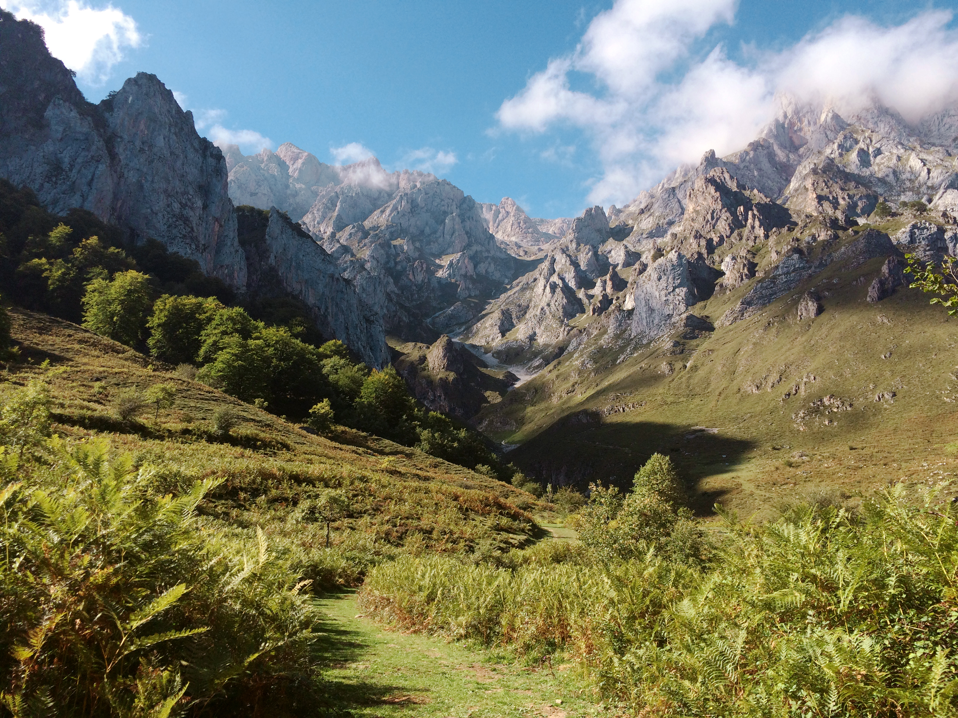
CIRCULAR
PARALLAX
ZOOM

Slide 4
CIRCULAR
PARALLAX
ZOOM

Slide 5
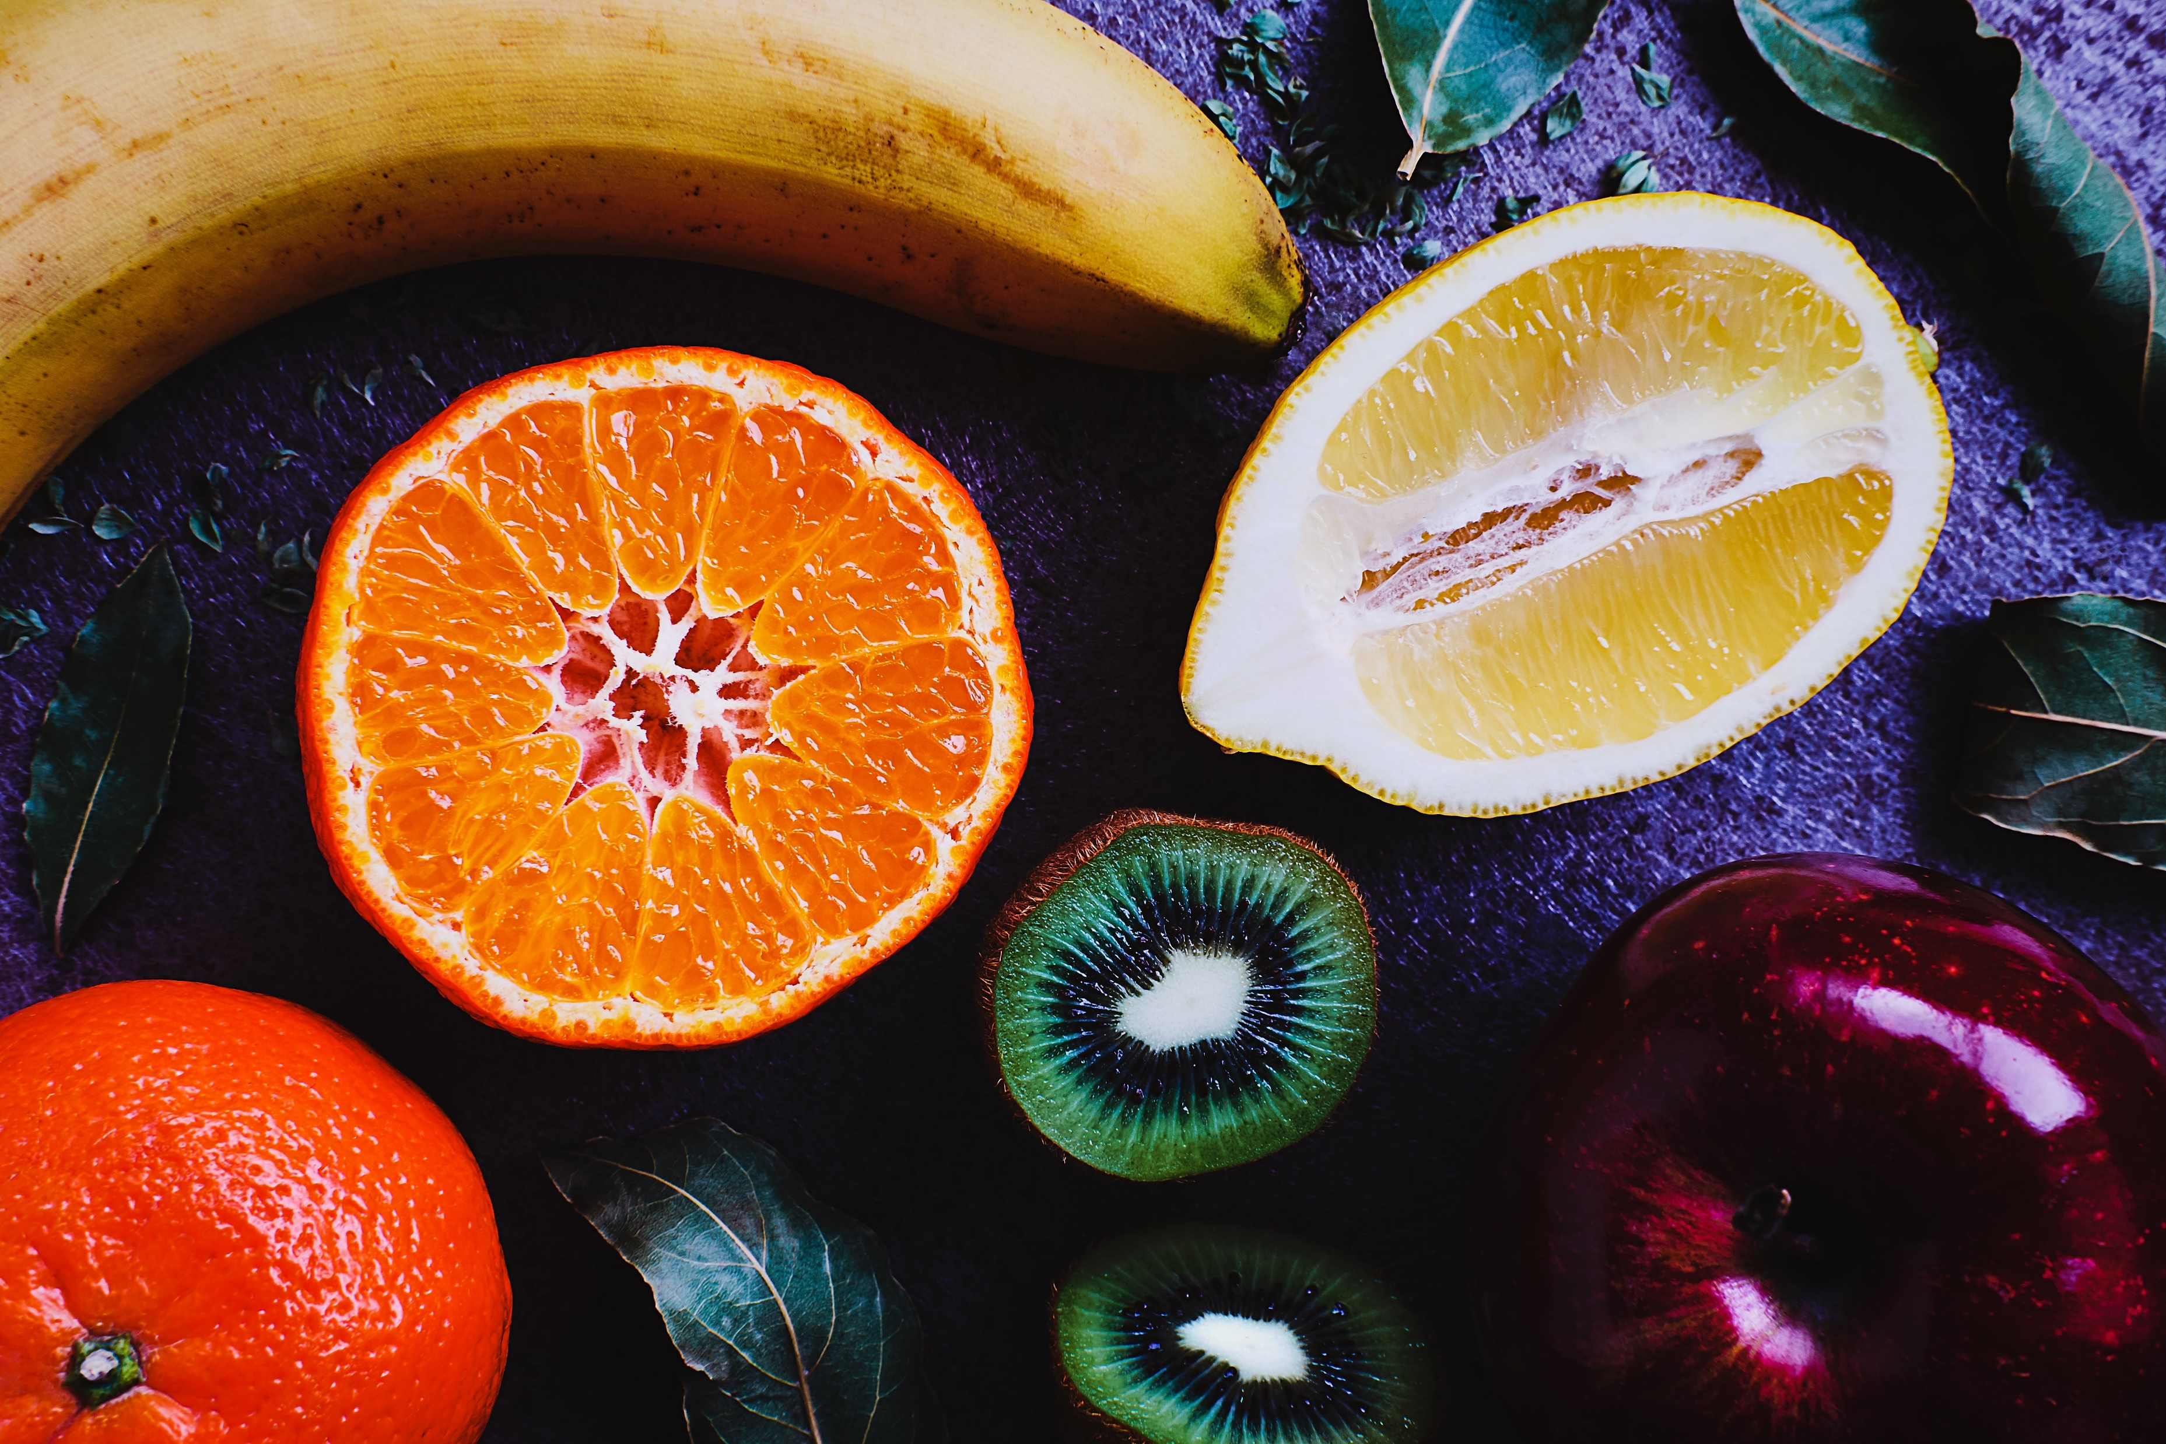

FEEL
THE
TASTE

Slide 6



FEEL
THE
TASTE

Slide 7

WRITE
IT
DOWN

Slide 8
WRITE
IT
DOWN

Slide 9

Sky is
The
limit

Slide 10
Sky is
The
limit

Slide 11

Let‘s
Make some
photos

Slide 12
Let‘s
Make some
photos

